Slide 1
Columbia Elementary School
School Improvement Plan 2019-2020

Slide 2
Data Sources Analyzed
WaKIDS (kindergarten readiness)
Fall iReady Reading and Mathematics
Fall Acadience data
SWIS Behavior Data
Spring 2019 Smarter Balanced Assessment Scores
Attendance Information
Demographic Data

Slide 3
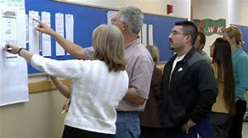
Data Review Process: Data Carousel
Whole staff review of all available school data
Phase 1: Small groups rotate between multiple data stations and record observations without inferences
Phase 2: Groups rotate again and highlight most critical elements that impact district goals.

Slide 4
Building Leadership Team
Analyze whole staff observations for themes and commonalities
Previous building priorities improved Phonological awareness and high frequency words much better than previous years; Behavior and attendance greatly improved
Third grade reading impacted by vocabulary weakness Vocabulary is key to comprehension
Fourth grade mathematics low overall Foundational skills need addressed

Slide 5
Instructional staff strategy brainstorming session:
What works and what
haven’t we tried?
Best Practices and Resources
What does research tell us and what is needed to make implementing key strategies possible?

Slide 6
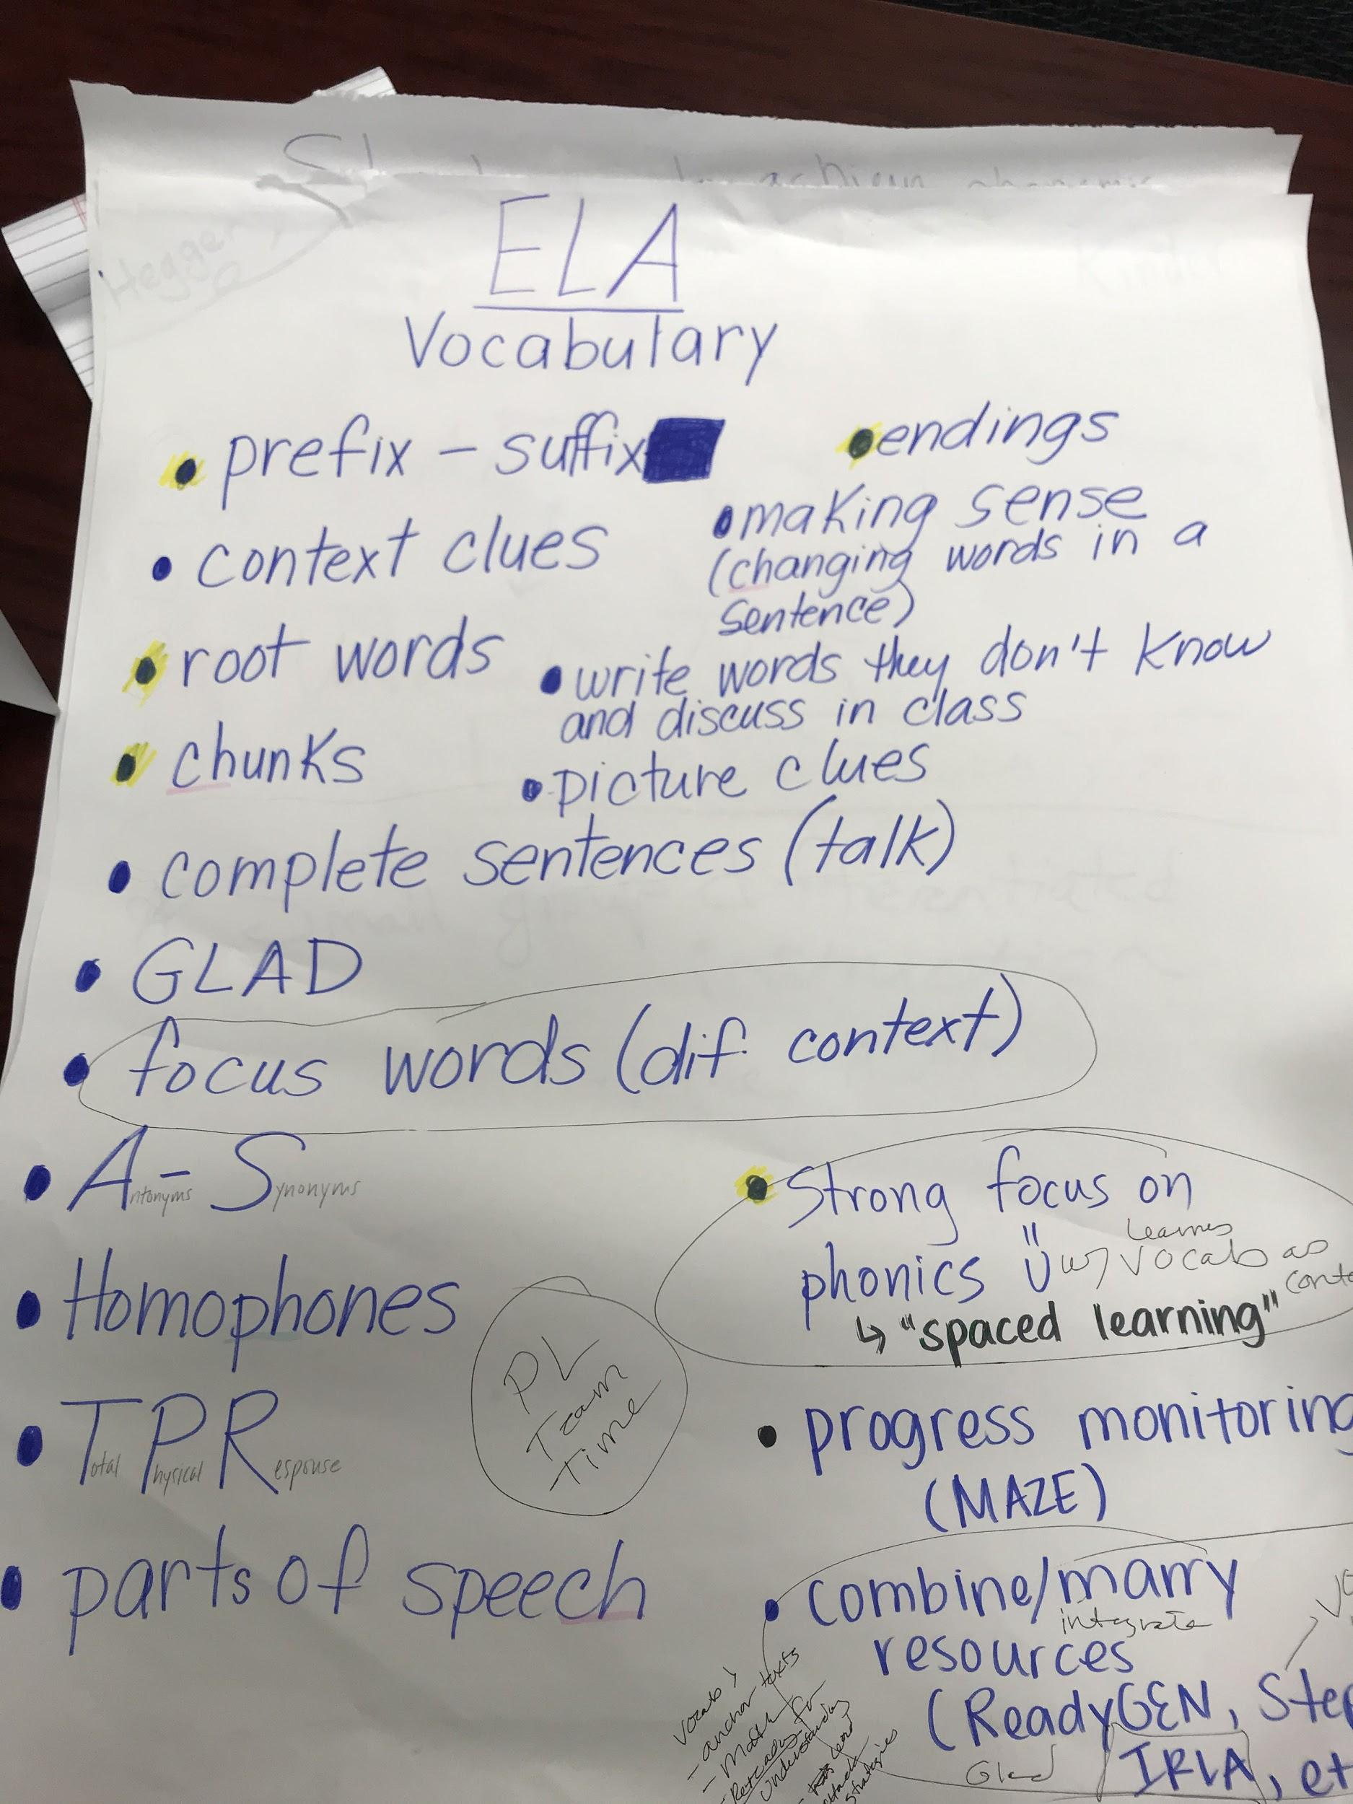
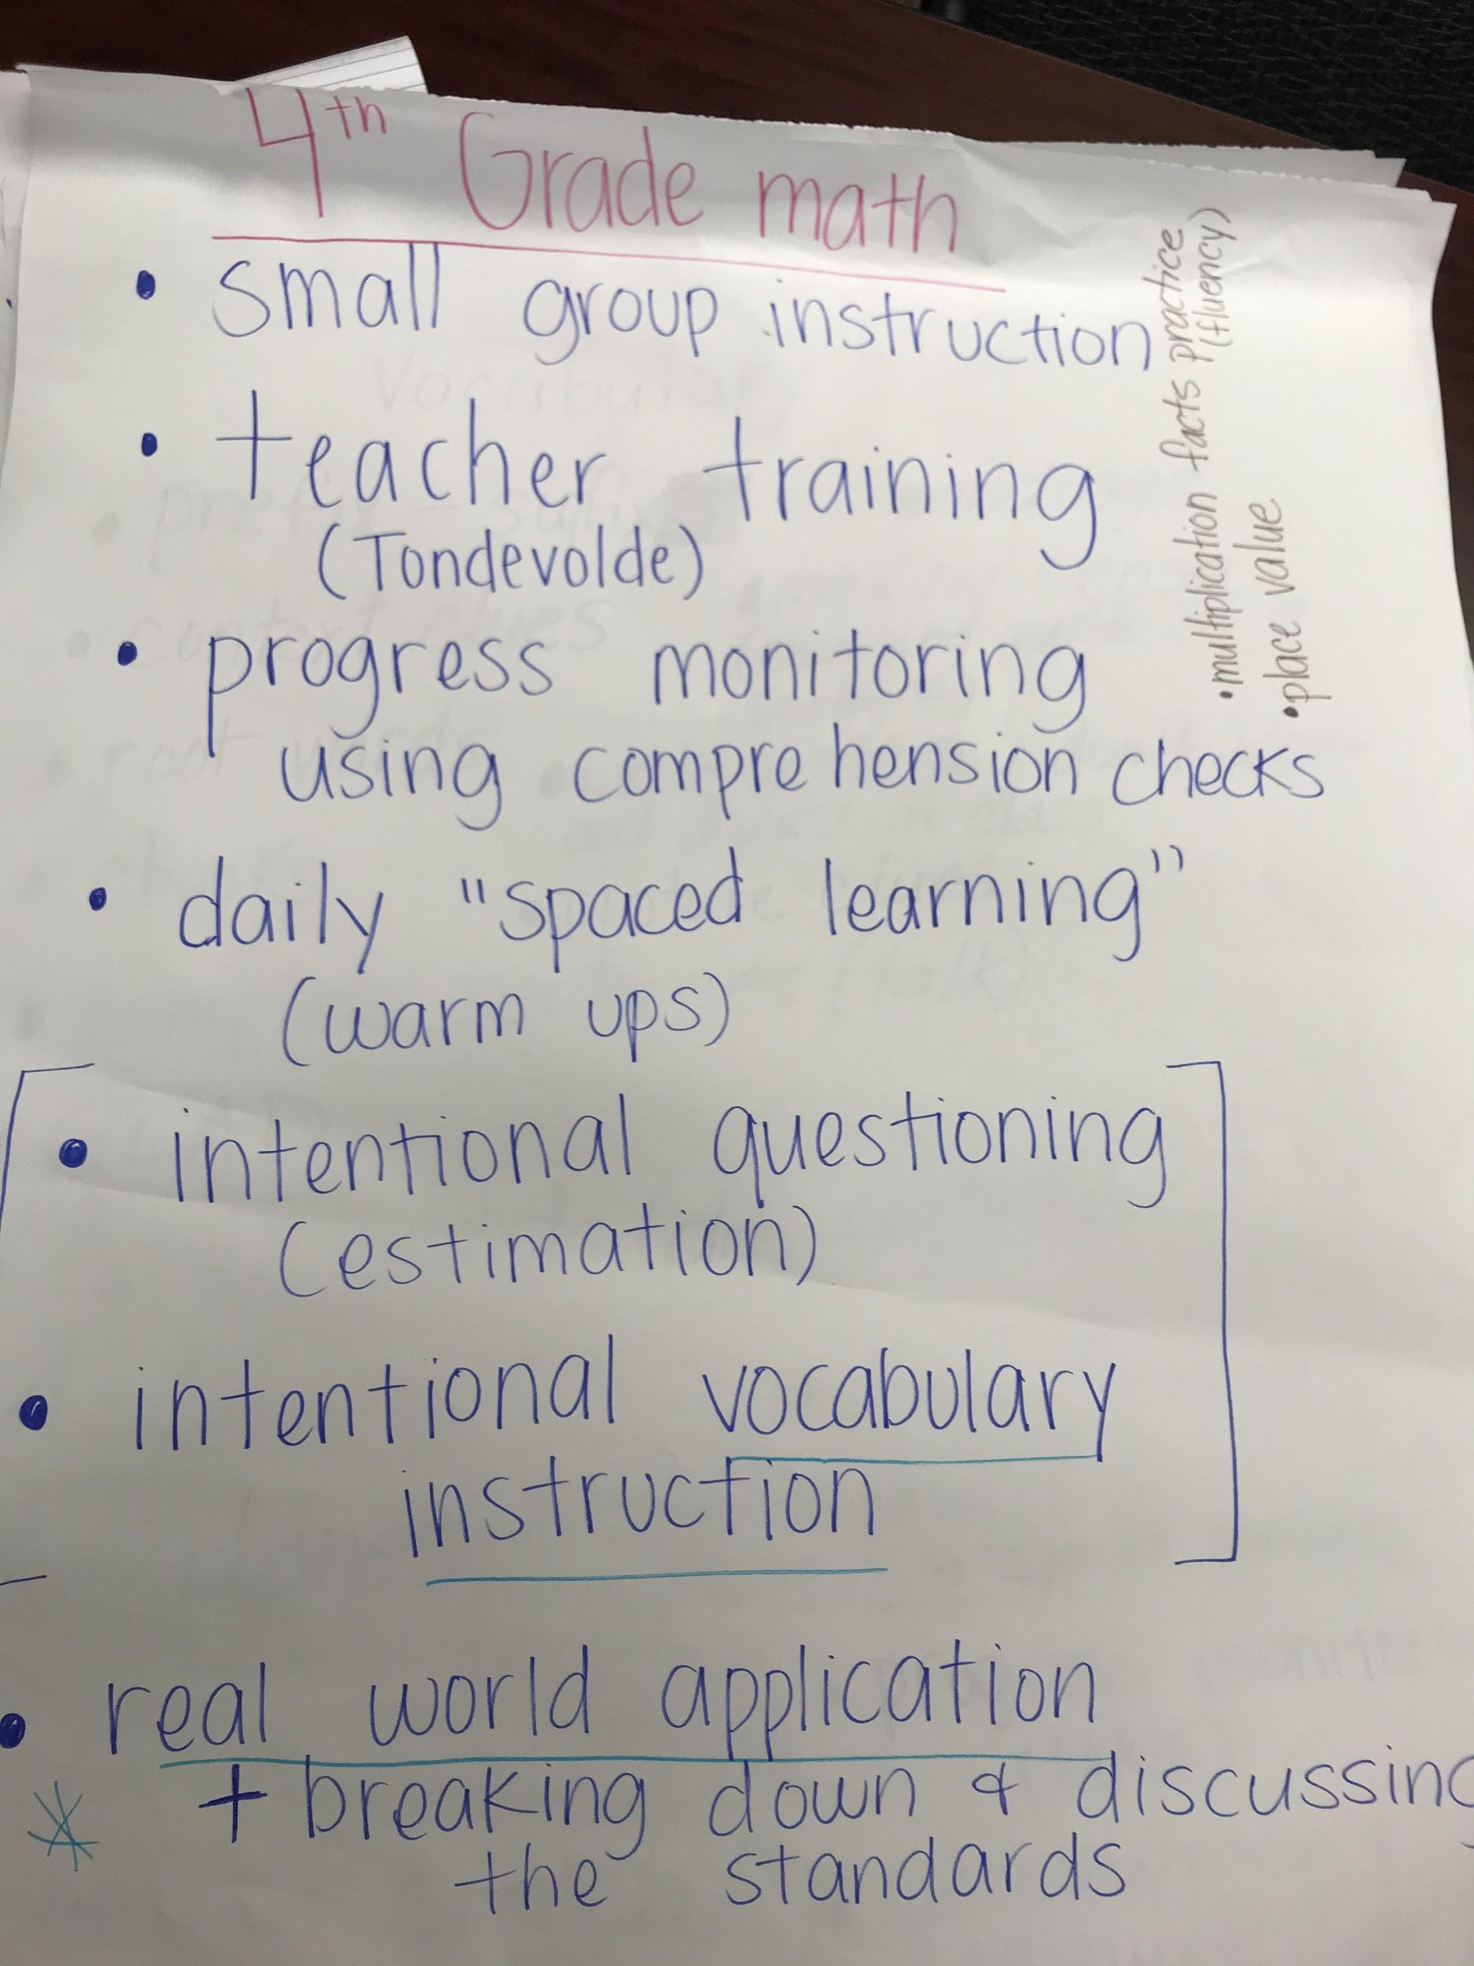
Consider all possibilities:
Strategies
All voices equally valued and represented
Ideas presented without concern for resource barriers
Grounded in success and research

Slide 7
Key Considerations:
Equity Lens
Maintain focus in areas of success
Prepare for transition to middle school
Bridge school readiness gaps early and aggressively
Entire staff effort toward building goals: We all support all students

Slide 8
Growth vs Proficiency
Goals developed with intentional focus on growth or proficiency
Growth
Students must make more than one year of growth to close achievement and opportunity gaps. One year of growth is the minimum desired result regardless of proficiency.
Proficiency Learners performing at grade level are considered proficient.

Slide 9
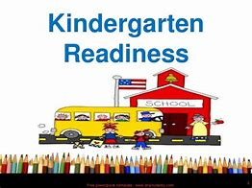
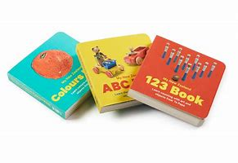
Kindergarten
31.7% of Woodland Primary students entered kindergarten ready for school in 2018-19 (WaKIDS).
Phonological awareness is foundational for learning to read.
This area of focus has improved greatly as a result of significant effort. A yearly priority must remain 100% proficiency for all kindergarteners.

Slide 10
Vocabulary is a key gateway to comprehension
One Year of Growth
Students achieving at least one year of growth in vocabulary in 3rd grade will support improvement in reading comprehension.

Slide 11
Fourth Grade
Mathematics proficiency is low in all areas assessed by iReady (numbers and operations, algebra and algebraic thinking, measurement and data, and geometry).
Numbers and operations is foundational for all areas of mathematics
Students achieving at least one year of growth in numbers and operations will have the foundation to continue growing in mathematical proficiency.

Slide 12
Timeline
September- October 2019
November 2019
February 2020
June 2020
Goals presented for approval
Data review and staff input
2019 |  |  |  | 2020
Review of progress and strategy refinements
Data analysis and goal review

Slide 13
Concrete and Focused Goals:
All kindergarten students will achieve proficiency in phonological awareness by June 10, 2020 as measured by Heggerty end-of-year assessment.
All third grade students will achieve at least one year of growth in vocabulary as measured by end-of-year iReady scale score.
All fourth grade students will achieve at least one year of growth in numbers and operations as measured by end-of-year iReady scale score.

Slide 14
Comments and Questions:
Thank you for your support!

